Slide 1

Security
Industrial IoT
Software and Services Group
IoT Developer Relations, Intel

Slide 2
LEGAL NOTICE
Intel technologies’ features and benefits depend on system configuration and may require enabled hardware, software or service activation. Performance varies depending on system configuration. No computer system can be absolutely secure. Check with your system manufacturer or retailer or learn more at www.intel.com.
Performance estimates were obtained prior to implementation of recent software patches and firmware updates intended to address exploits referred to as "Spectre" and "Meltdown." Implementation of these updates may make these results inapplicable to your device or system.
Cost reduction scenarios described are intended as examples of how a given Intel-based product, in the specified circumstances and configurations, may affect future costs and provide cost savings. Circumstances will vary. Intel does not guarantee any costs or cost reduction.
This document contains information on products, services and/or processes in development. All information provided here is subject to change without notice. Contact your Intel representative to obtain the latest forecast, schedule, specifications and roadmaps.
Any forecasts of goods and services needed for Intel’s operations are provided for discussion purposes only. Intel will have no liability to make any purchase in connection with forecasts published in this document.
ARDUINO 101 and the ARDUINO infinity logo are trademarks or registered trademarks of Arduino, LLC.
Altera, Arria, the Arria logo, Intel, the Intel logo, Intel Atom, Intel Core, Intel Nervana, Intel Xeon Phi, Movidius, Saffron and Xeon are trademarks of Intel Corporation or its subsidiaries in the U.S. and/or other countries.
*Other names and brands may be claimed as the property of others.
Copyright 2018 Intel Corporation.

Slide 3
Security Is Critical
"It takes 20 years to build a reputation and five minutes to ruin it. If you think about that, you'll do things differently.“
—Warren Buffet on Target Corp
Notes:
Find case studies for large breaches 2017
Equifax revealed that 145.5 million consumer accounts were compromised in a data breach.
Yahoo recently disclosed that every single account it had as of 2013 was compromised in a data breach that year.

Slide 4
Intel® Platform Trust Technology: Protected Storage
Intel® PTT is a hardware TPM 2.0 implementation for credential storage and key management across Atom, Core and Xeon. Benefits:
A secure trust element to meet requirements for TPM 2.0 and Measured Boot for systems on which TPM 2.0 is required.
Integrated solution
Compliance with: TCG specifications, TPM Profile commands, EK cert provisioning, ECC, SHA2, Windows 10 requirements
Protects: anti-replay, dictionary attack
Key protection technology for distributed HW Security Module (HSM)
Reduction in BOM cost and board savings as compared to a discrete TPM, or use with a Discrete TPM (for geo or vendor-specific)
This is have existing installations can perform TE
Notes:
https://www.intel.in/content/www/in/en/data-center-efficiency/enterprise-security-platform-trust-technology-white-paper.html
https://rd.springer.com/content/pdf/10.1007%2F978-1-4302-6572-6_7.pdf 2014 so dated, but chapter 7 on PTT

Slide 5





Protecting the execution, storage, and transfer of data
Intel hardware based security allows you to protect every level of your deployment
1
Hardware Rooted Security: Hardware integrity must be enforced to ensure the device has not been altered.
From the Field
A lack of security in implanted medical devices opens the door for malicious activity that could put patient health at risk.
Industrial devices, if tampered with, can leak sensitive operational data.
Hackers may breach retail devices to gain insight into sales patterns, change prices, or hide inventory.
2
Operating System Security: The gateway itself must have a secure operating system to ensure that data is safely stored.
3
Network Security: Data must be transmitted securely from sensor to data center, even when one or more gateways must process it on the way.
4
Ecosystem security: Standardized Intel solutions allow augmented security with third-party solutions.
Security and privacy are the top two inhibitors of the success of IoT deployments.
Recent survey of more than 450 IT and business leaders¹

Slide 6
Security Technologies
Intel® Trusted Execution Technology (Intel® TXT)
Intel® Software Guard Extensions (Intel® SGX)
Intel® Data Protection Technology with AES-NI and Secure Key
Intel® Enhanced Privacy ID (Intel® EPID)

Slide 7
Intel® Trusted Execution Technology (Intel® TXT)
Provisioning Know Good BIOS and Hypervisor
Verified Launch. A hardware-based chain of trust that enables launch of the MLE into a “known good” state. Changes to the MLE can be detected through cryptographic (hash-based or signed) measurements.
Launch Control policy (LCP). A policy engine for the creation and implementation of enforceable lists of “known good” or approved, executable code.
Secret protection. Hardware-assisted methods that remove residual data at an improper MLE shutdown, protecting data from memory-snooping software and reset attacks.
Attestation. The ability to provide platform measurement credentials to local or remote users or systems to complete the trust verification process and support compliance and audit activities
1
If mismatched, policy enforces untrusted status
Measuring BIOS
3
If matched, policy enforces trusted status
2
If mismatched, policy enforces untrusted status
Measuring Hypervisor
5
4
If matched, policy enforces trusted status
Notes:
https://www.intel.com/content/www/us/en/architecture-and-technology/trusted-execution-technology/trusted-execution-technology-security-paper.html
Intel TXT is specifically designed to harden platforms from the emerging threats of hypervisor attacks, BIOS, or other firmware attacks, malicious root kit installations, or other softwarebased attacks. It increases protection by allowing greater control of the launch stack through a Measured Launch Environment (MLE) and enabling isolation in the boot process. More specifically, it extends the Virtual Machine Extensions (VMX) environment of Intel® Virtualization Technology (Intel® VT), permitting a verifiably secure installation, launch, and use of a hypervisor or operating system (OS).

Slide 8
Intel® SGX
Secure Execution Enclaves
Protected memory
Cannot be accessed by anyone other than application
Enclave memory is encrypted
Minimize attack surface
Notes:
https://software.intel.com/en-us/articles/intel-software-guard-extensions-tutorial-part-1-foundation
Whitepaper: https://eprint.iacr.org/2016/204.pdf
Intel SGX is a set of CPU instructions that enable applications to create enclaves: protected areas in the application’s address space that provide confidentiality and integrity even in the presence of privileged malware. Enclave code is enabled by using special instructions, and it is built and loaded as a Windows* Dynamic Link Library (DLL) file.
Enclave memory cannot be read or written from outside the enclave regardless of the current privilege level and CPU mode.
Production enclaves cannot be debugged by software or hardware debuggers. (An enclave can be created with a debug attribute that allows a special debugger—the Intel SGX debugger—to view its content like a standard debugger. This is intended to aid the software development cycle.)
The enclave environment cannot be entered through classic function calls, jumps, register manipulation, or stack manipulation. The only way to call an enclave function is through a new instruction that performs several protection checks.
Enclave memory is encrypted using industry-standard encryption algorithms with replay protection. Tapping the memory or connecting the DRAM modules to another system will yield only encrypted data (see Figure 2).
The memory encryption key randomly changes every power cycle (for example, at boot time, and when resuming from sleep and hibernation states). The key is stored within the CPU and is not accessible.
Data isolated within enclaves can only be accessed by code that shares the enclave.

Slide 9
Intel® AES-NI and Secure Key
Advanced Encryption Standard – New Instructions
Xeon Server Encryption Hardware Accelerator Instructions
Secure Transactions, Enterprise Database, Full Disk Encryption
OS Libraries, 3rd Party Libraries, Compile
Digital Random Number Generator
Notes:
https://software.intel.com/en-us/articles/intel-digital-random-number-generator-drng-software-implementation-guide
DRNG uses hardware entropy source (thermal noise) to generate random numbers
From: https://www.intel.com/content/www/us/en/enterprise-security/enterprise-security-aes-ni-white-paper.html
TL;DR:
Intel AES-NI provides a new set of processor instructions that will first be available in servers based on the Intel Xeon processor 5600 series. These instructions enable fast and secure data encryption and decryption. Since AES is the dominant block cipher, and it is deployed in various protocols, the new instructions will be valuable for a wide range of applications.
The architecture consists of six instructions that offer hardware support for AES. Four instructions support AES encryption and decryption, and the other two instructions support AES key expansion. A seventh new instruction, CLMUL, accelerates the GCM mode for AES, assisting in ECC, general purpose CRCs, as well as data de-duplication. Together, these instructions offer a significant increase in performance compared to pure software implementations.
The AES instructions have the flexibility to support all three standard AES key lengths, all standard modes of operation, and even some nonstandard or future variants. Beyond improving performance, the AES instructions provide important security benefits. Since the instructions run in data-independent time and do not use lookup tables, they help in eliminating the major timing and cache-based attacks that threaten table-based software implementations of AES. In addition, these instructions make AES simple to implement, with reduced code size. This helps reduce the risk of inadvertent introduction of security flaws.
Compilers That Support Intel® AES-NI: Microsoft Visual C++* 2008 SP1, Intel V11.0, GCC 4.4.0+ and Linux* Binutils
Details:
Encryption provides increasingly important data protection for helping remain compliant with HIPAA, SOX, PCI and other regulations.
HIPAA 4 Health Insurance Portability and Accountability Act of 1996:
Information systems housing patient health information must be protected from intrusion.
When information flows over open networks, some form of encryption must be utilized.
Potential penalty for noncompliance: 10-year prison sentence and $100 fine per incident with a maximum of $25,000 per year.
HiTECH Act February 17, 2010: •
Extended the reach of the HIPAA Privacy and Security Provisions to business associates (BAs).
Covered entities must provide major media notice whenever a breach involves more than 500 individuals in a state.
If personal health information is rendered “unusable, unreadable or indecipherable,” no notifi cation is required.
A major security breach that results in actual damages can lead to class action lawsuits, regulatory action, drop in stock price and damage to reputation and customer relationships. •
Sets encryptions standards for “unusable, unreadable or indecipherable” data at rest and in motion.
Sarbanes-Oxley Act7 (SOX):
Requires all publicly held U.S. companies to comply with strict information technology guidelines to protect the integrity and confi dentiality of fi nancial information.
ISO/IEC 27002 (an information security standard) defines best practices for SOX-related security controls and explicitly suggests the use of encryption.
Potential penalty for noncompliance: 10-year prison sentence and $15,000,000 fi ne.
Payment Card Industry (PCI) Data Security Standard:
Requires Primary Account Numbers (PAN) and/or credit card numbers to be encrypted while at rest.
Members of the organization include Visa, MasterCard, American Express, Discover, and others.
Members have the right to quit accepting credit card transactions from noncompliant institutions and assess fines of $500,000.
AES: Advanced Encryption Standard. A slightly modified version of the Rijindael algorithm, AES is an encryption standard adopted by the U.S. government in 2001. AES is displacing the older, less secure 3DES (Data Encryption Standard) with 112 or 168 bit key lengths. AES is a block cipher, which means it works on fixedlength groups of bits, which are called blocks.
Intel AES-NI (Advanced Encryption Standard New Instructions) is a set of new instructions in the Intel® Xeon® processor 5600 series (formerly codenamed Westmere-EP). Intel AES-NI implements in the hardware some sub-steps of the AES algorithm. This speeds up execution of the AES encryption/decryption algorithms and removes one of the main objections to using encryption to protect data: the performance penalty.
Intel AES-NI adds six new AES instructions, four for encryption and decryption, one for the mix column, and one for generating next round text.
Intel AES-NI also includes a seventh new instruction: CLMUL. This instruction could speed up the AES-GCM and binary Elliptical Curve Cryptography (ECC), and assists in error correcting codes, general purpose cyclic redundancy checks (CRCs), and data de-duplication.
AES Usage Models:
Secure Transactions – HTTPS, SSL & IP SEC
Enterprise Applications – Database encryption - Oracle Database*, IBM DB2, Microsoft SQL Server*, Microsoft Access, and MySQL*
Full Disk encryption - BitLocker Drive Encryption in Windows* Server 2008, PGPdisk, and McAfee* Total Protection for Endpoint
ISVs have three ways they can implement Intel AES-NI. They can:
Use the instructions by using OS libraries - ISVs can take advantage of the crypto application programming interfaces (APIs) specific for a particular OS dynamically, without doing specific encryption algorithm optimization work. At the middleware and infrastructure level, the standard OS cryptographic libraries can be called from the code path.
Use the instructions using third-party libraries –
Intel® Integrated Performance Primitives Library The Intel IPP cryptography function domain is a suite of pre-built public-key, symmetric and hashing functions that conform to the U.S. government’s NIST Federal Information Processing Standards (FIPS) specifi cations. ISVs can use Intel IPP to quickly build robust, high-performance cryptographic modules and applications.
Java* Cryptography Extensions (JCE) The Java Cyptography Extension (JCE) provides a framework and implementations for encryption, key generation and key agreement, and MAC algorithms. Its encryption support includes symmetric, asymmetric, block, and stream ciphers, in addition to supporting secure streams and sealed objects.
RSA* BSAFE* RSA* BSAFE* is a very pervasive and popular free download module. RSA BSAFE supports the FIPS approved DSA, rDSA (RSA ANSI X9.31), DES and TDES Modes, and SHA-1 algorithms.
Crypto++ Crypto++ Library is a free C++ class library of cryptographic schemes consisting of implementations of AES, Diffi e-Hellman Key Exchange, RSA cryptography, elliptic curve cryptography, and digital signature algorithm. AES-GCM, AES-CCM, and AES-CBC modules are available for download.
OpenSSL* This collaborative effort provides a robust, commercial-grade, full-featured and open source toolkit implementing the Secure Sockets Layer (SSL v2/v3) and Transport Layer Security (TLS v1) protocols. The OpenSSL Project also provides a strong general-purpose cryptography library. Managed by a worldwide community of volunteers, the project uses the Web to communicate, plan, and develop its OpenSSL toolkit and related documentation.
Linux* Kernel The Linux kernel is released under the GNU General Public License version 2 (GPLv2) and is developed by contributors worldwide. There are proprietary licenses for some controversial binary large objects (BLOBs).
Code the application insertion themselves using the new instructions - Applications that do not leverage libraries for AES ciphers should consider adding Intel AES-NI support using an upcoming compiler (Table 2). Popular industry compilers support Intel AES-NI programming either using intrinsics or assembly. (Visual C++* 2008, V11.0, GCC)

Slide 10

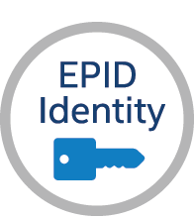

Hardware Identity management
Prevents Attack Mapping- Protects device data vs PKI that reveals data to hack device
Baseline Minimum
HW Root of Trust
Intel® Enhanced Privacy ID (Intel ® EPID)
TCG/ISO standard with privacy preserving group authentication scheme
Used to authenticate & open secure, authenticated channel for remote attestation
Proven- 2.5 Billion keys fused into Intel processors since 2008. Intel® Xeon®, Intel® Core™, & Intel® Atom™
Open source SDK
Used by Intel solutions- SGX, DRM, IPT, Intel® Secure Device Onboard
EPID vs. PKI
Intel® EPID
Traditional PKI
Secure App
Container “TEE”
Attest SW
HW Identity
1-to-many key match, unique signature every time, anonymous
1-to-1 key match, standard signature every time
Pvt-Key 1
Pvt-Key 2
…
Pvt-Key X
Pvt-Key
Enables Customers to deliver many use cases where privacy & attestation are key requirements

Slide 11
Security Applications
Hyperledger Sawtooth
Intel Secure Device Onboard

Slide 12
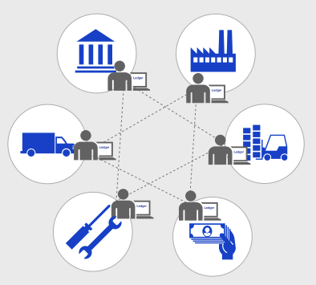
Hyperledger Sawtooth
Distributed Ledger a.k.a. Blockchain
Utilizes Intel® SGX
Uses Proof of Elapsed Time (PoET) instead of Proof of Work
Provides Separate Application Layer
Ethereum Compatability

Slide 13
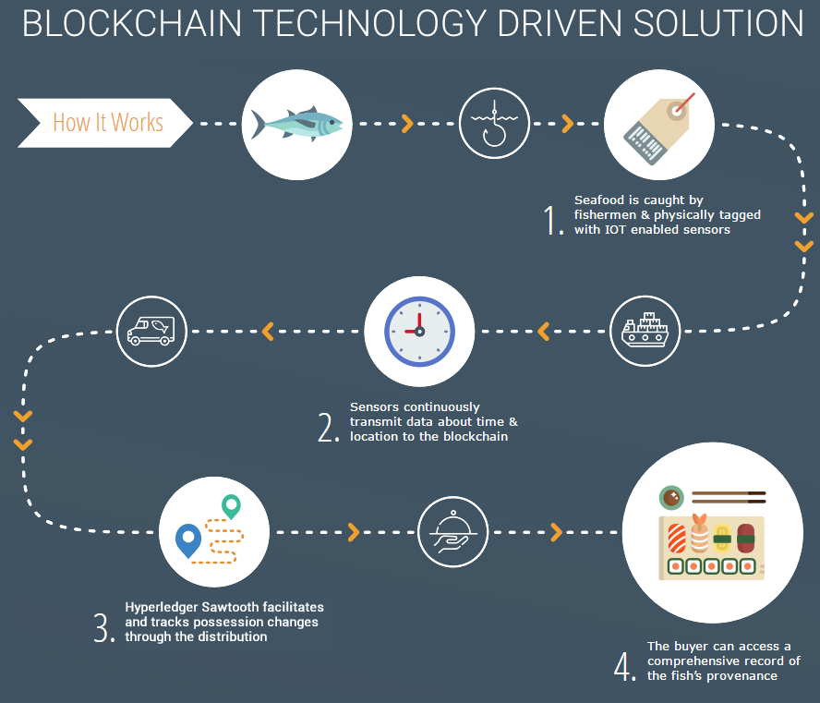
Sawtooth use case

Slide 14
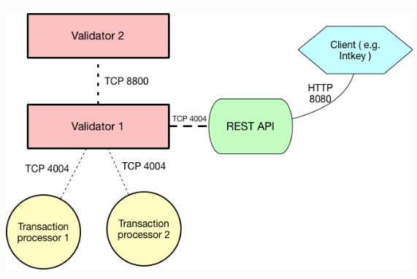
Sawtooth getting started
https://sawtooth.hyperledger.org
SDK: Python, Go, JavaScript, RUST (C++, Java WIP)
Docker
Ubuntu 16.04 Package
AWS Marketplace

Slide 15
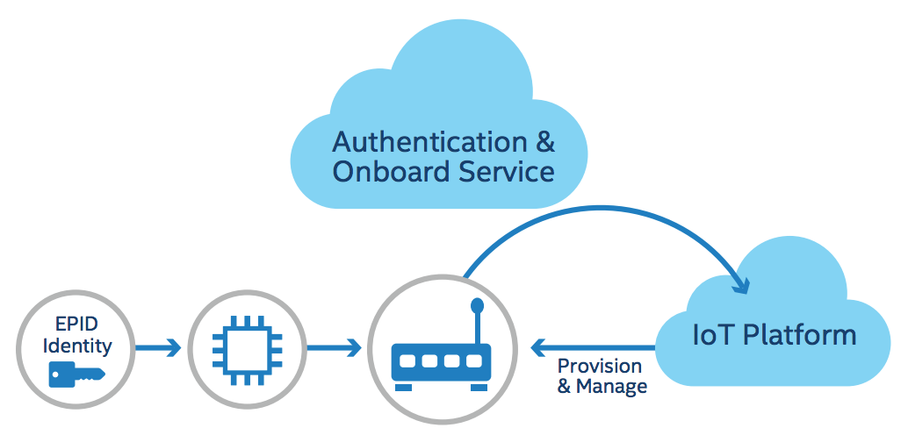
Intel® SDO
EPID
Zero Touch Onboarding Service
Automatically Discover and Provision Device in Field
Secure and Scalable

Slide 16
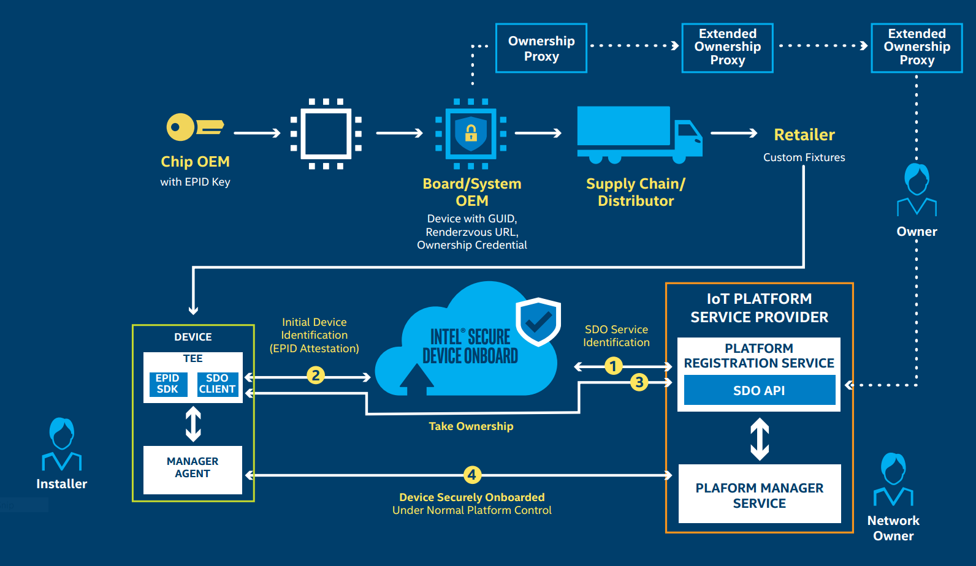
Intel® SDO - Use Case Flow

Slide 17
Security Further Reading
Hardware Based Security Technologies Land Page
Practical UEFI Secure Boot - Part 1, Part 2, Part 3
Intel® Identity Protection Technology (Intel® IPT)
Intel® Data Protection Technology with AES-NI and Secure Key
Intel® Trusted Execution Technology (Intel® TXT)
Hardware-Assisted Intel® Virtualization Technology
Intel® SGX Code Samples

